Slide 1
The Impact of Recent AI Advances on Kingsmen
March 2023
Kingsmen Engineering

Slide 2
The Impact of AI on the Workforce
AI Overview
ChatGPT
Other AI Tools
Microsoft 365 Copilot Announcement
Next Steps

Slide 3
“Surrender your desk job to the AI productivity miracle”
AI could eventually increase annual global GDP by 7% over a 10-year period, driven by a combination of significant labor cost savings, new job creation and higher productivity for non-displaced workers
7% of workers will lose their jobs completely in the next 10 years if AI reaches half of employers
18% of the global workforce could be automated by AI
46% of administrative jobs and 44% of legal jobs can be substituted by AI
25% of all current work tasks could be automated by the U.S. and Europe
The Impact of AI
Goldman Sachs Research

Slide 4
Machine Learning: This involves training a computer system to learn from data and make predictions or decisions without being explicitly programmed. It is used in many applications, including image recognition, natural language processing, and fraud detection.
Deep Learning: This is a subset of machine learning that involves training artificial neural networks to learn and make decisions. In deep learning, the neural network is trained using a process called backpropagation, which involves adjusting the weights and biases of the neurons in response to the error between the predicted output and the actual output. This process is repeated multiple times, with the network gradually improving its performance over time. It is used in applications such as speech recognition, image classification, and natural language processing.
Reinforcement Learning: This involves training a computer system to learn through trial and error, using rewards and punishments to guide its decision-making. It is used in applications such as game playing, robotics, and autonomous vehicles.
AI Overview
High-level AI Definitions

Slide 5
Natural Language Processing (NLP): NLP enables computers to understand, interpret, and generate human language. Applications include sentiment analysis, machine translation, chatbots like ChatGPT, and AI personal assistants like Siri and Alexa.
Computer Vision: Computer vision deals with the analysis and interpretation of images and videos. This technology is used for object recognition, facial recognition, optical character recognition (OCR), autonomous vehicles, and surveillance systems.
Image Generation: Generative models like Generative Adversarial Networks (GANs) and Variational Autoencoders (VAEs) are used for generating realistic images, creating artwork, and improving video game graphics.
Subsets of AI That
Kingsmen Can Leverage

Slide 6
Natural Language Processing (NLP)
AI Used for Tools Like ChatGPT
This type of AI involves teaching computers to understand and interpret human language, including speech and text. It is used in applications such as chatbots, virtual assistants, and sentiment analysis.
An NLP product that has been in the news recently is ChatGPT. ChatGPT is a large language model trained by OpenAI that is designed to respond to natural language queries and generate human-like responses. It uses a deep learning algorithm that has been trained on a vast amount of text data to understand the context of a user's query and generate a relevant response. ChatGPT is capable of answering a wide range of questions and engaging in conversation on a variety of topics. It is intended to be a useful tool for research, education, and entertainment, as well as a demonstration of the capabilities of modern artificial intelligence.
The current version of ChatGPT was trained on a massive dataset of text known as the Common Crawl corpus. This dataset contains over 45 terabytes of text data that was collected from the internet and includes web pages, online books, and other sources. There are multiple versions of the GPT model created by OpenAI. There are currently two used by ChatGPT. GPT-3.5 has been in use for some time. GPT-4 was just added as an option in mid-March. They were both trained on a subset of the Common Crawl corpus containing approximately 570GB of text data. They also received additional training on other sources of text data, such as Wikipedia, books, and news articles. Overall, GPT is one of the largest and most advanced language models in existence, with over 175 billion parameters and the ability to generate highly complex and nuanced responses. Both versions were trained on a dataset from late 2021, so they are not up to date on all topics.

Slide 7
Natural Language Processing (NLP)
AI Used for Tools Like ChatGPT
Here are just a few of the known improvements in GPT-4 versus GPT-3.5:
Improved performance on standardized exams
It can accept visual inputs in addition to text
Reduction in hallucinations
Increase in the max request length from 4096 tokens (which is ~3 pages of single-lined English text) to 8192 tokens as standard, and limited access to gpt-4-32k which has a maximum length of 32768 tokens.
ChatGPT: https://chat.openai.com/chat
OpenAI Playground:
https://platform.openai.com/playground?mode=chat
More information about GPT-4:
https://openai.com/product/gpt-4
https://openai.com/research/gpt-4

Slide 8
ChatGPT
Summarize content of emails, documentation, etc.
Extract action items from emails or other content
Refine emails (e.g. change the tone)
Assist with writing documentation
Create or refine blog posts
Research almost any topic
General Use Cases of Interest

Slide 9
ChatGPT
Story writing assistance
Create stories from a prompt
Use it to analyze gherkin and provide feedback
Convert functions into stories
Modeling assistance
Coding assistance
From snippets to complete applications
Generate test data
Generate SQL
Assist in the creation of Excel formulas
Specific Use Cases of Interest

Slide 10

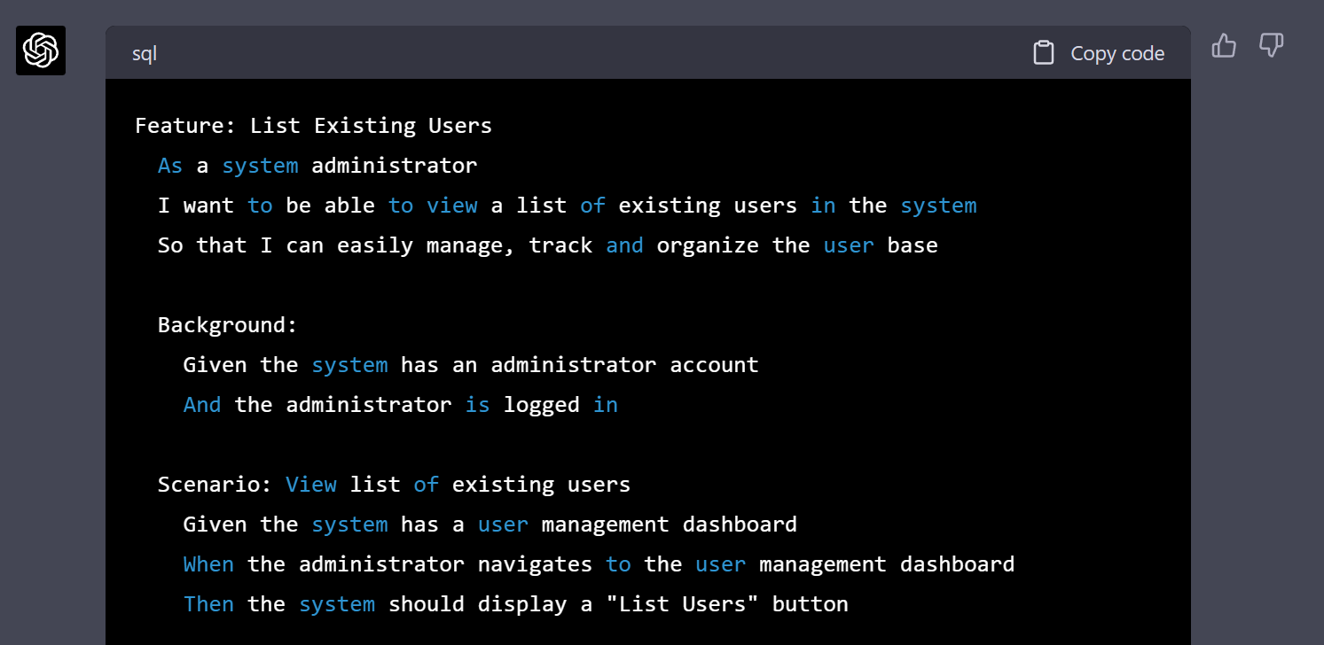
Story Writing Assistance
ChatGPT understands the Gherkin syntax
ChatGPT can create complete user stories based on a prompt

Slide 11
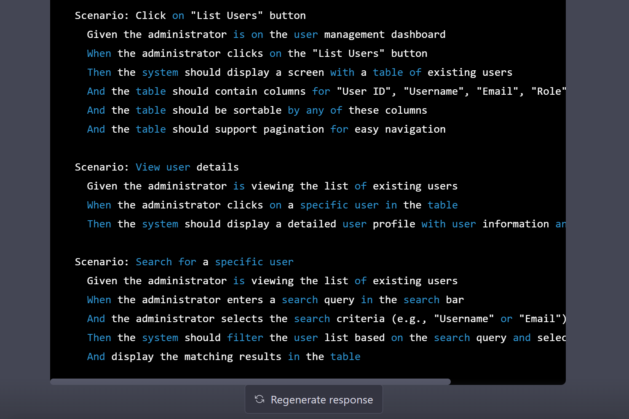
Story Writing Assistance
ChatGPT understands the Gherkin syntax

Slide 12
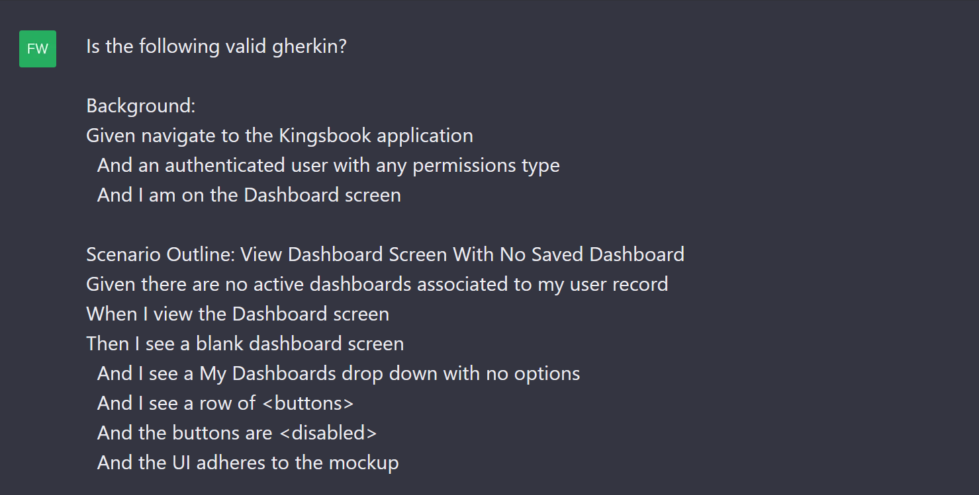
Story Writing Assistance
ChatGPT understands the Gherkin syntax
ChatGPT can analyze existing user stories/gherkin and provide feedback and suggestions

Slide 13
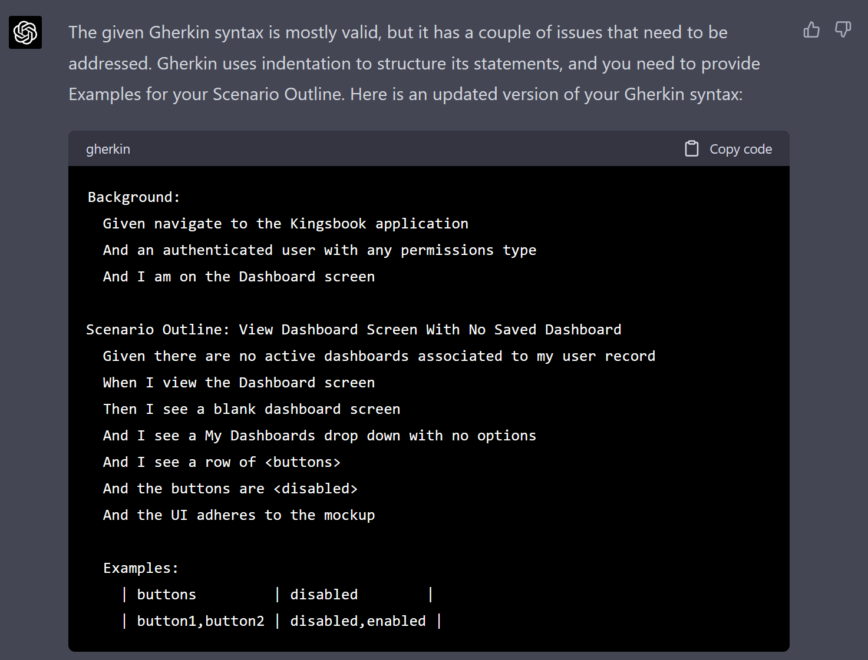
Story Writing Assistance
ChatGPT understands the Gherkin syntax

Slide 14
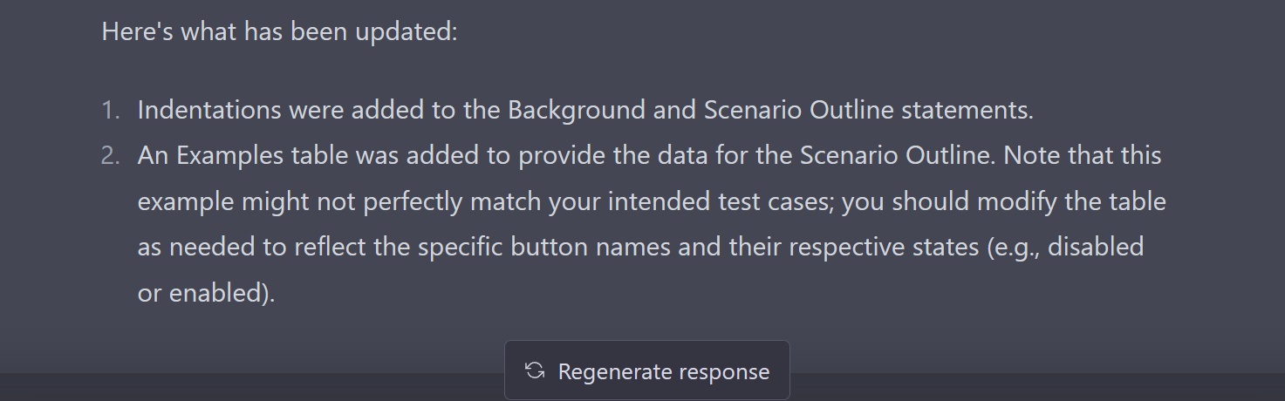
Story Writing Assistance
ChatGPT understands the Gherkin syntax

Slide 15

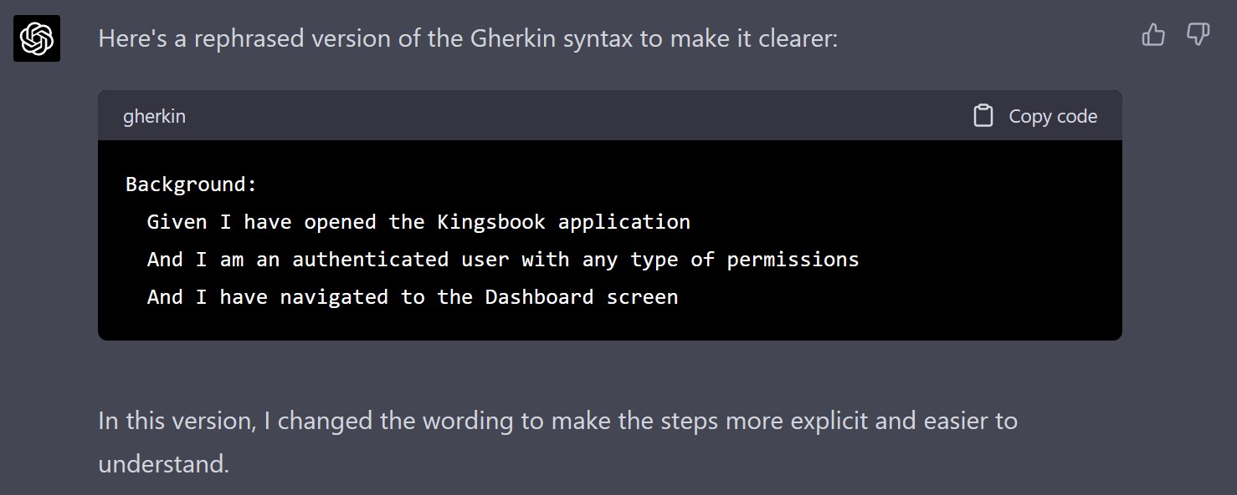
Story Writing Assistance
ChatGPT understands the Gherkin syntax
ChatGPT can refine the gherkin content to make it easier to read

Slide 16

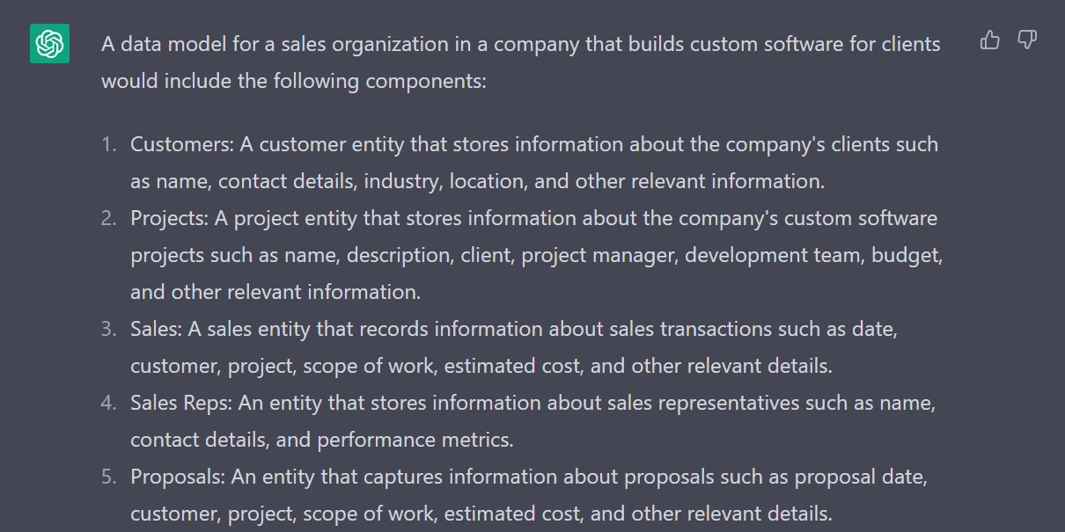
Modeling Assistance
ChatGPT understands many types of models
ChatGPT can create descriptions of many types of models from simple prompts.

Slide 17
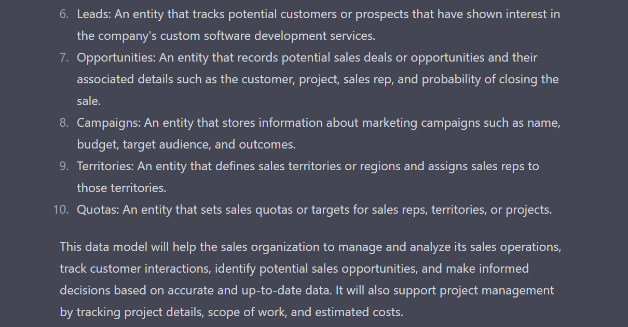
Modeling Assistance
ChatGPT understands many types of models

Slide 18
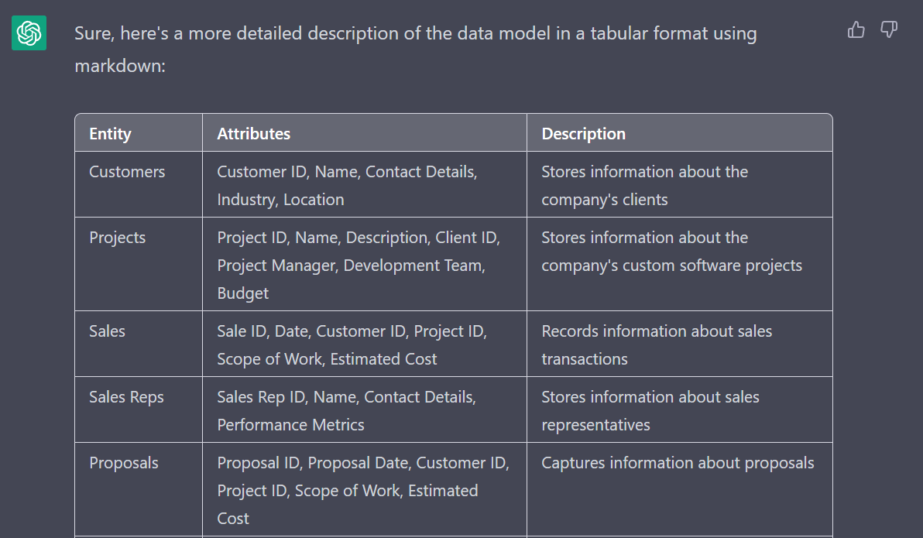
Modeling Assistance
ChatGPT understands many types of models
ChatGPT can also format the model in Markdown.

Slide 19
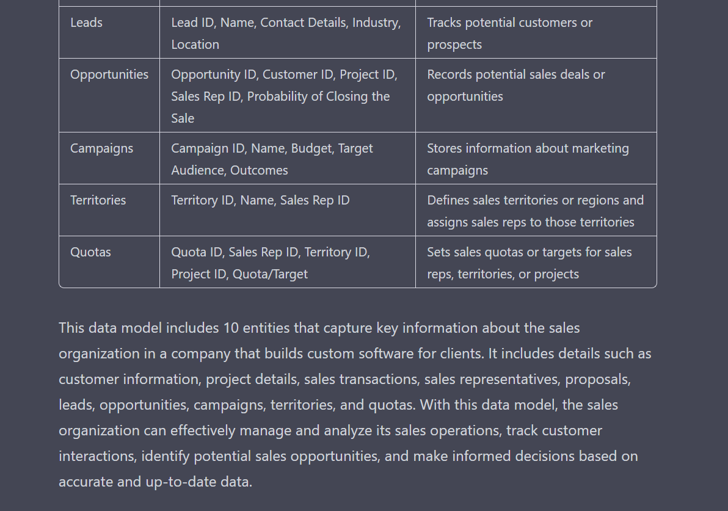
Modeling Assistance
ChatGPT understands many types of models

Slide 20
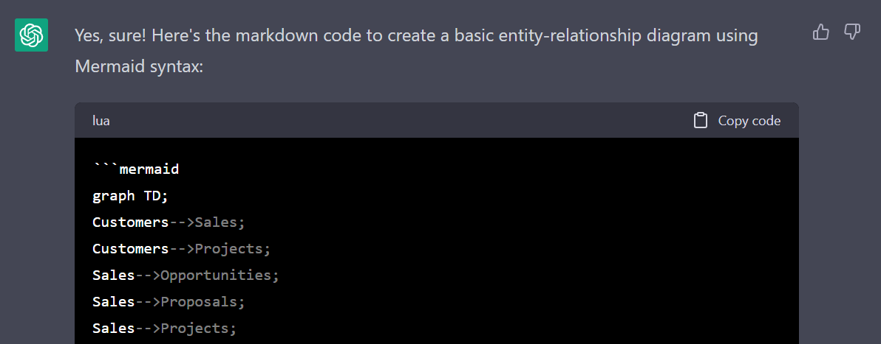
Modeling Assistance
ChatGPT can build visual diagrams and charts using MermaidJs syntax
ChatGPT can also format the data for MermaidJs, which renders in compatible tools as a diagram or chart.

Slide 21
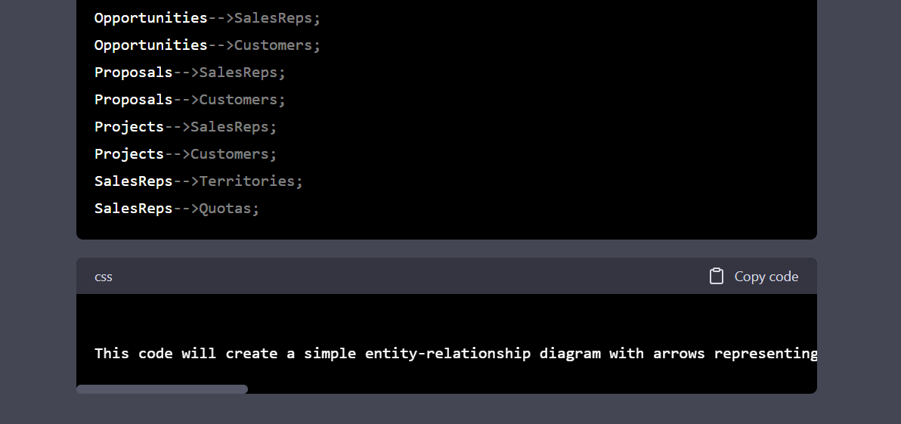
Modeling Assistance
ChatGPT can build visual diagrams and charts using MermaidJs syntax
The full text of the last code block is: This code will create a simple entity-relationship diagram with arrows representing the relationships between the entities. You can copy and paste this code into a markdown editor that supports Mermaid syntax, such as Typora or Visual Studio Code, to create the diagram. You can also customize the diagram to your liking by adding labels or adjusting the layout.

Slide 22
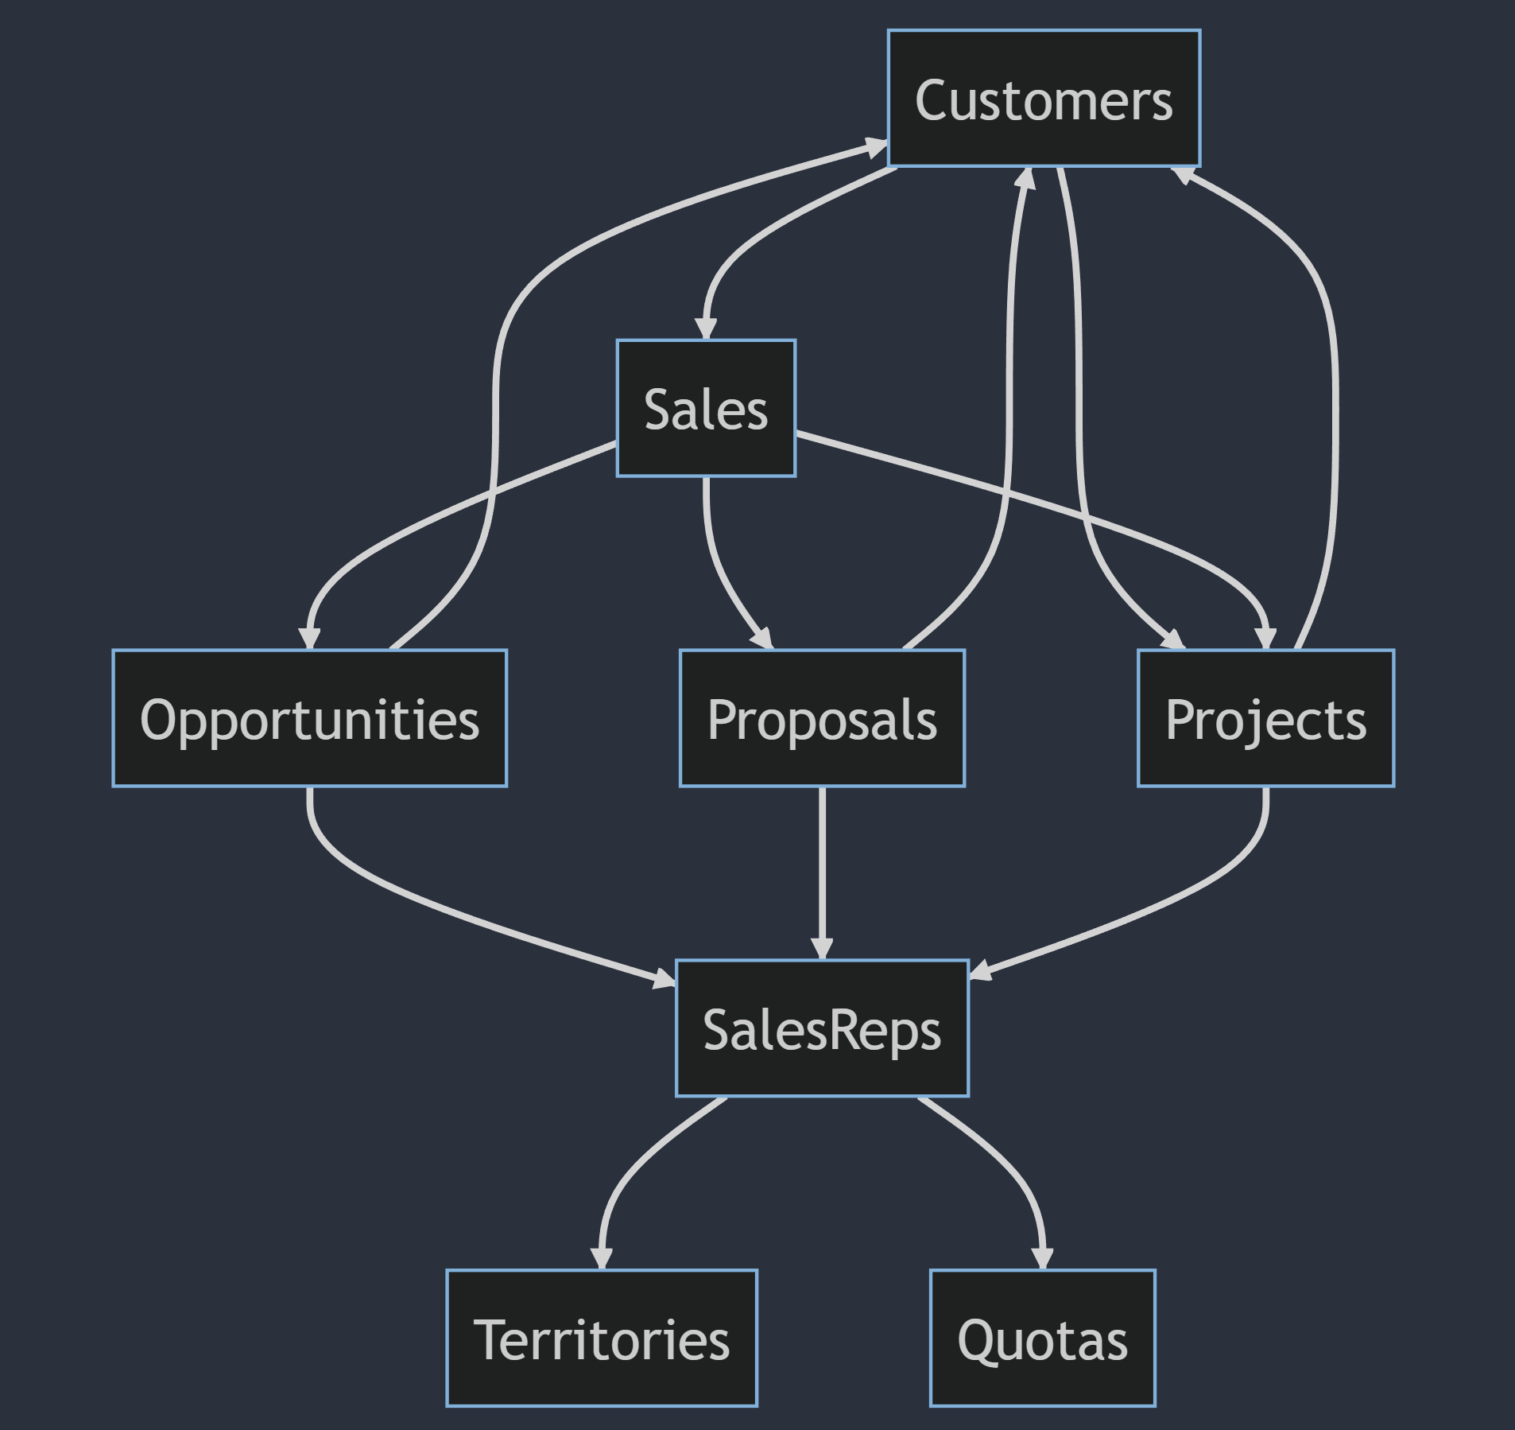
Modeling Assistance
ChatGPT can build visual diagrams and charts using MermaidJs syntax
That MermaidJs markup renders as shown below in a compatible tool.

Slide 23
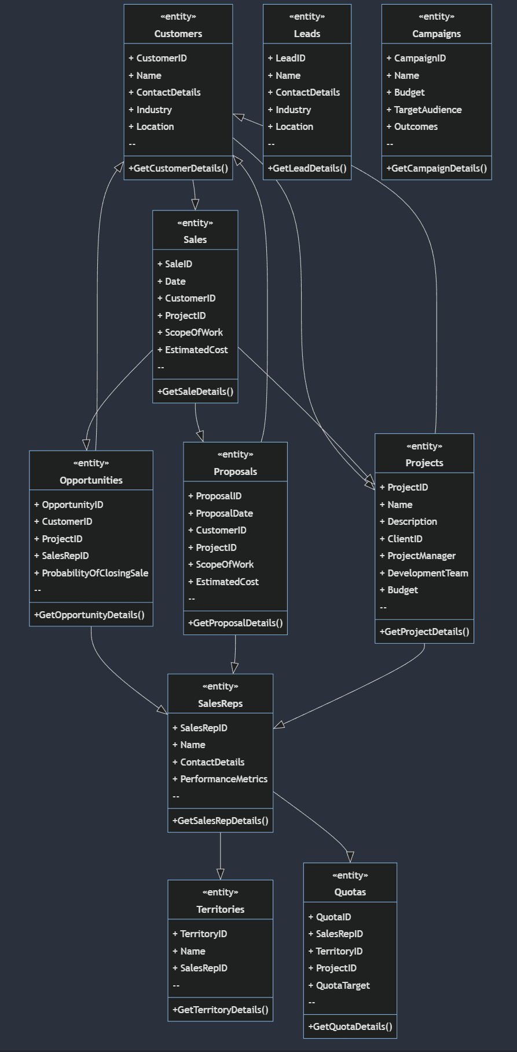

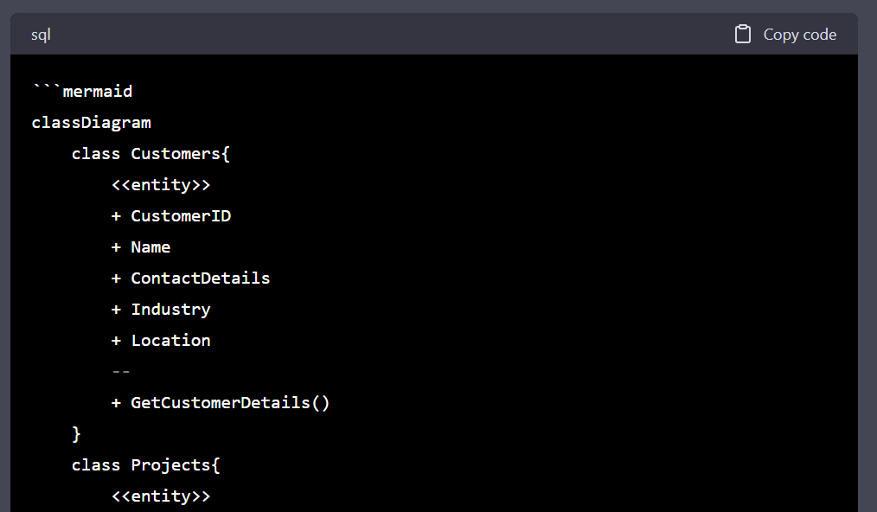
Modeling Assistance
ChatGPT can build class diagrams

Slide 24
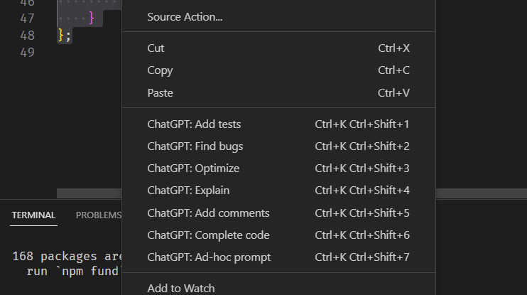
Coding Assistance
From snippets to entire applications
ChatGPT understands many programming languages and can help with various coding such as:
Writing code given an ad hoc prompt
Explaining a block of code
Optimizing a block of code
Finding bugs in a block of code
Creating comments for a block of code
Adding unit tests for a block of code
There are already plugins for Visual Studio and VS Code that allow two-way interaction between the IDE and ChatGPT.

Slide 25
Other AI Tools
There are a wide variety of tools we may leverage
GitHub Copilot (detailed docs)
GitHub Copilot Labs
GitHub Copilot X
GitHub TestPilot
OpenAI Whisper – speech to text and translation
OpenAI Playground – allows for control over the model and various parameters which affect the results
GPT integration with Microsoft Edge and Bing
Microsoft announcement
TechCrunch update regarding GPT-4
Microsoft Designer (article about it and another product named Image Creator)
Microsoft Loop
Microsoft Visual ChatGPT – (TomsGuide article)
ChatGPT competitors
Google Bard
Hugging Face
Jasper - best used for writing (blogs, Twitter threads, etc.)

Slide 26
Microsoft 365 Copilot Announcement
GPT gets integrated into every Microsoft 365 application
On March 16th, Microsoft announced Microsoft 365 Copilot. Copilot is integrated into Microsoft 365 in two ways. It works alongside you, embedded in the Microsoft 365 apps you use every day—Word, Excel, PowerPoint, Outlook, Teams, and more—to unleash creativity, unlock productivity, and uplevel skills. They also announced an entirely new experience: Business Chat. Business Chat works across the LLM, the Microsoft 365 apps, and your data—your calendar, emails, chats, documents, meetings, and contacts—to do things you’ve never been able to do before. You can give it natural language prompts like “tell my team how we updated the product strategy” and it will generate a status update based on the morning’s meetings, emails, and chat threads.
https://news.microsoft.com/reinventing-productivity/
https://www.microsoft.com/en-us/microsoft-365/blog/2023/03/16/introducing-microsoft-365-copilot-a-whole-new-way-to-work/

Slide 27
Next Steps
Where do we go from here?
Experiment with ChatGPT for various daily tasks we do
Provide suggestions for deep dives
Machine Learning/AI Club will start the second week of April
Join the ai-club Slack channel

